Slide 1
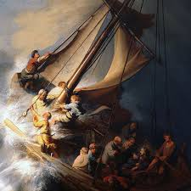
OASIS CHURCH 11.8.24.
Is Jesus in your boat?
Rembrandt

Slide 2
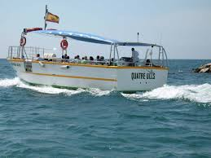
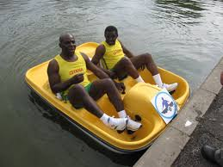
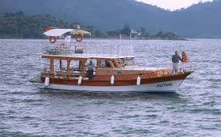
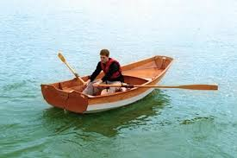
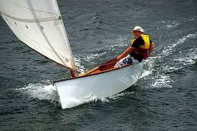
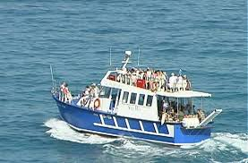
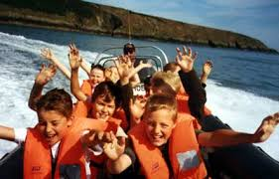
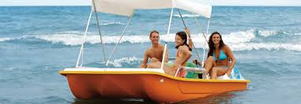
Who has been on a boat trip?

Slide 3
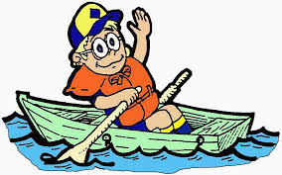
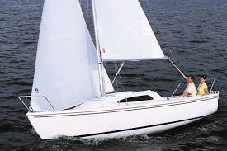
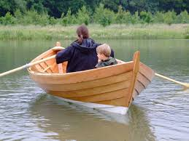
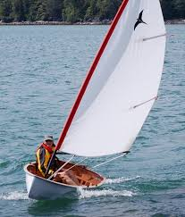
On a small
boat?

Slide 4
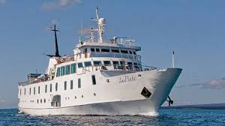
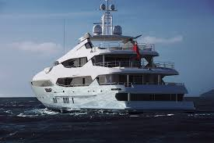
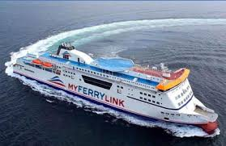
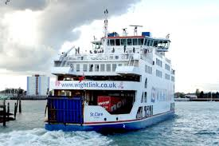
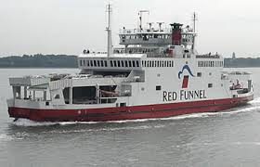
On a medium sized boat-like a ferry?

Slide 5
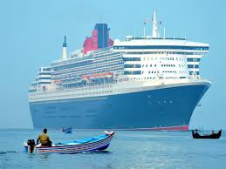
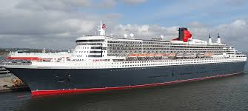
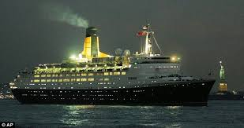
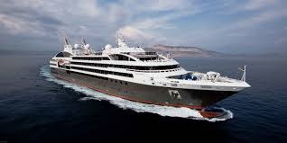
Or a very big boat like an Ocean Liner?

Slide 6
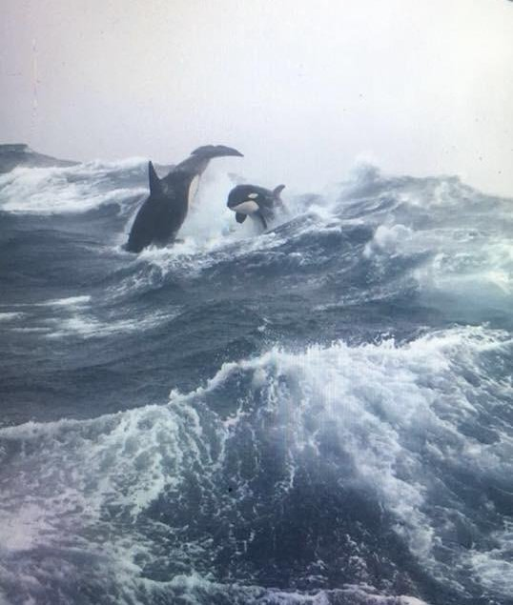

Slide 7
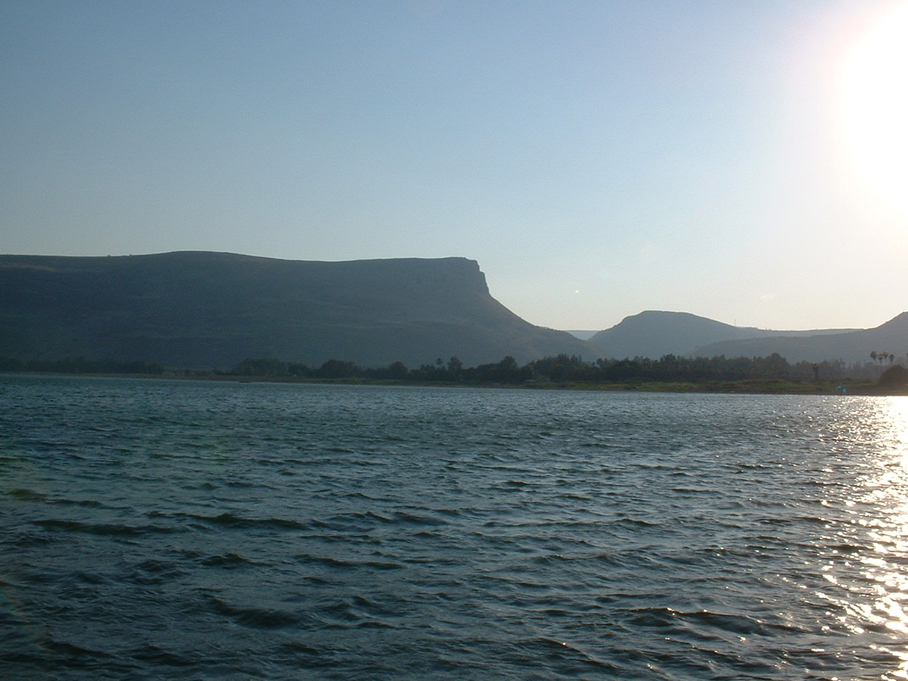

Slide 8
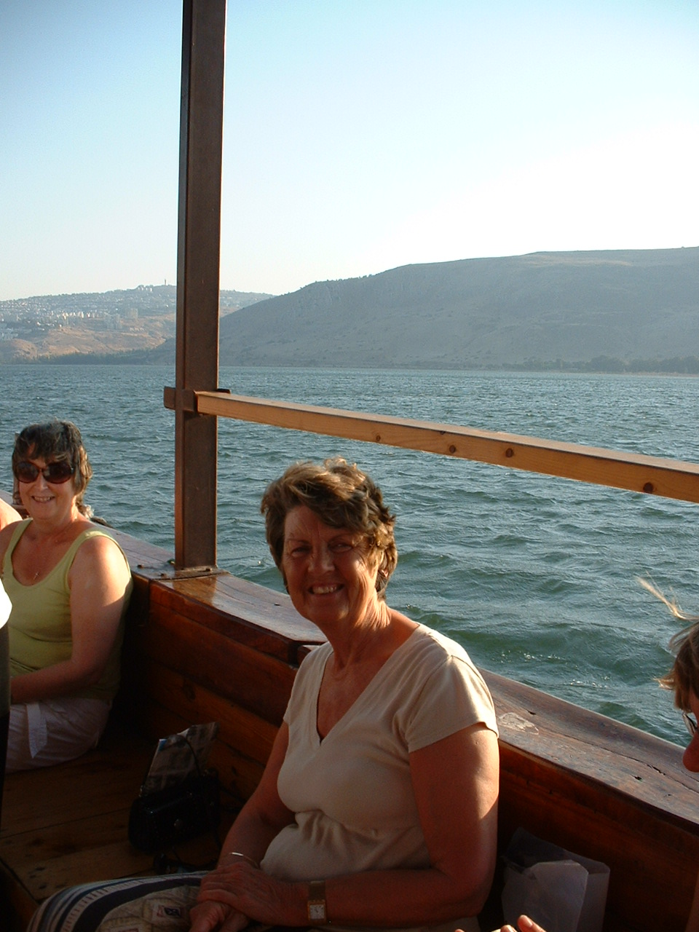

Slide 9
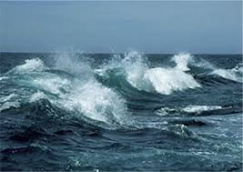

Slide 10
The Scary Boat trip.
Jesus-Hooray (arms waving.)
Friends –shake hands with someone near you and smile.
Wind- whooooo…..
Waves- splash, crash…… (arms up and down like waves.)
Tired /tiring-Yawn (hand to mouth.)
Ghost- Oh no! (look scared)
Rembrandt

Slide 11
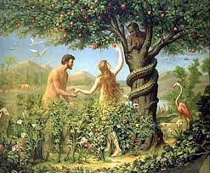

Slide 12
ROMANS 8:1 (NLT)
So now there is no condemnation for those who belong to Christ Jesus.

Slide 13
JOHN 16:33 (NASB)
These things I have spoken to you so that in Me you may have peace. In the world you have tribulation, but take courage; I have overcome the world.”

Slide 14
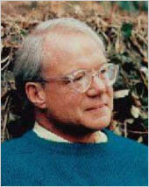
DR. SCOTT PECK 1936-2005
The Road Less travelled.
"Life is difficult. This is a great truth, one of the greatest truths.
It is a great truth because once we truly see this truth, we transcend it.
Once we truly know that life is difficult – once we truly understand and accept it – then life is no longer difficult. Because once it is accepted, the fact that life is difficult no longer matters."

Slide 15
JOHN 14:27(NLT)
“I am leaving you with a gift—peace of mind and heart. And the peace I give is a gift the world cannot give. So don’t be troubled or afraid.

Slide 16
Shalom
Biblical scholars say that the concept of peace rooted in ‘Shalom’ meant salvation, wholeness, integrity, soundness, connectedness (to others and creation)
righteousness, justice and well being (physical, spiritual and psychological)

Slide 17
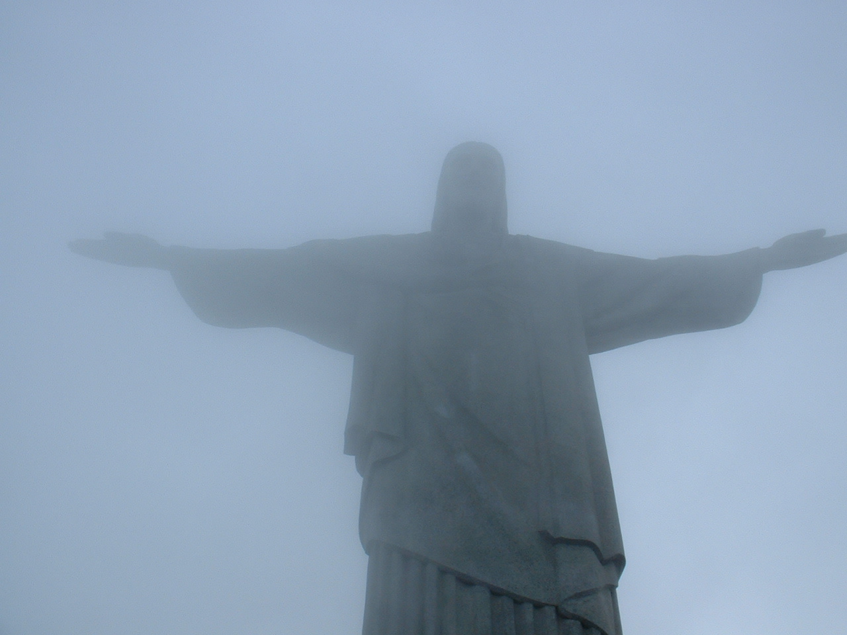
JOHN 20:19-21(NKJV)
That Sunday evening the disciples were meeting behind locked doors because they were afraid of the Jewish leaders. Suddenly, Jesus was standing there among them! “Peace be with you,” he said. Again, he said, “Peace be with you. As the Father has sent me, so I am sending you.”

Slide 18
JOHN 20:26 (NKJV)
Eight days later the disciples were together again, and this time Thomas was with them. The doors were locked; but suddenly, as before, Jesus was standing among them. “Peace be with you,” he said.

Slide 19
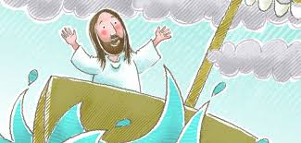
When storms arise we need Jesus in our boat!

Slide 20
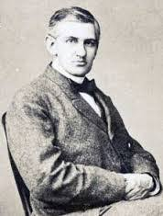
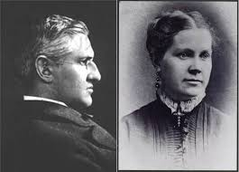
Horatio Spafford 20.10.1828- 16.10 1888
He was a successful American Lawyer and elder in the Presbyterian church, married to Ann.

Slide 21
1 .When peace like a river attendeth my way,
When sorrows like sea billows roll;
Whatever my lot Thou hast taught me to say,
“It is well, it is well with my soul!”
It is well with my soul!
It is well, it is well with my soul!
2. Though Satan should buffet, though trials should come;
Let this blest assurance control,
That Christ hath regarded my helpless estate,
And hath shed His own blood for my soul.

Slide 22
3 My sin—oh the bliss of this glorious thought—
My sin, not in part, but the whole,
Is nailed to His Cross, and I bear it no more;
Praise the Lord, praise the Lord, O my soul!
4 For me, be it Christ, be it Christ hence to live;
If Jordan above me shall roll,
No pang shall be mine, for in death as in life
Thou wilt whisper Thy peace to my soul.
5. But, Lord, ’tis for Thee, for Thy coming we wait, The sky, not the grave, is our goal; Oh, trump of the angel! Oh, voice of the Lord! Blessed hope, blessed rest of my soul!

Slide 23
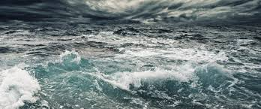
When I am in the middle of a storm Jesus, I invite you into my boat. When I am lost and need to find my way…
Jesus, I invite you into my boat.
When I am hurt and want to find healing…
Jesus, I invite you into my boat. When I am at the crossroads and don’t know which way to turn…
Jesus, I invite you into my boat.
When I’m confused and want to make the right choice…
Jesus, I invite you into my boat.
When I’ve made a mess of things…
Jesus, I invite you into my boat.
When I cannot fix the things that are broken…
Jesus, you are welcome in my boat. AMEN

